Slide 1

DAMG - 6210
Data Management and Database Design
Topic : E – Commerce
Group – 2
Saketh Vootla
Archie Sanghavi
Nikita Reddy
Revanth Katha
Tejasvi Bhadrinath

Slide 2
Problem Statement
E-commerce provides an easy way to sell products to a large customer base. When users land on an e-commerce site, they expect to find what they are looking for quickly and easily. The purpose of any e-commerce project is to help customers narrow down their broad ideas and enable them to finalize the products they want to purchase without any hassle.
Highlights
Data Encryption
Centralization of Records
Interactive UI
Real Time Analysis

Slide 3
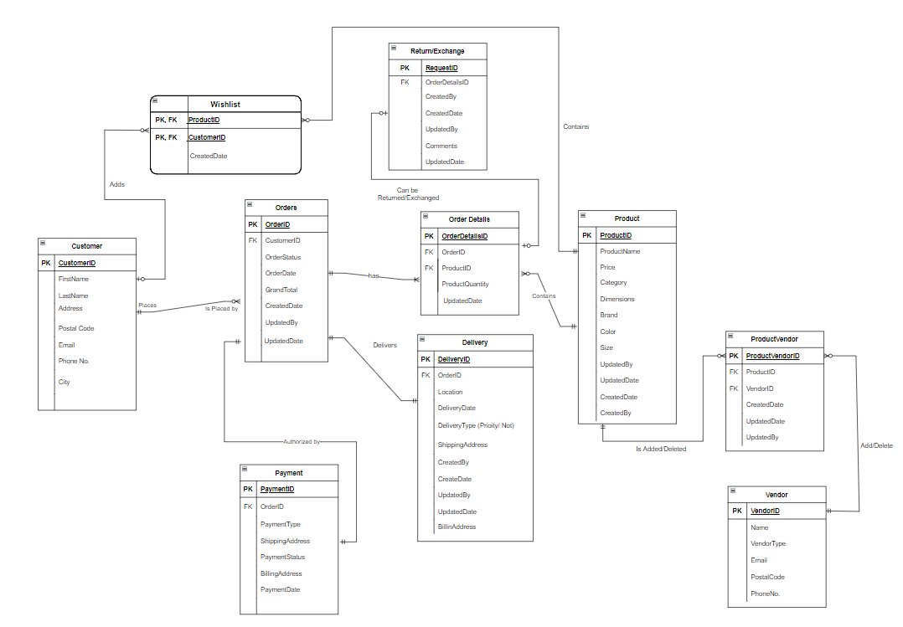
ENTITY RELATIONSHIP DIAGRAM

Slide 4
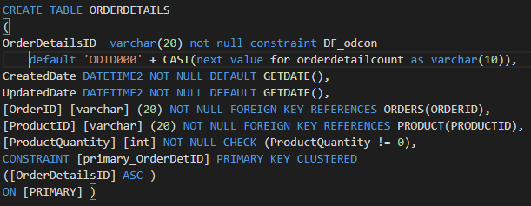
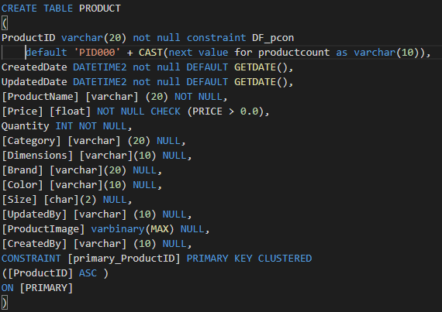
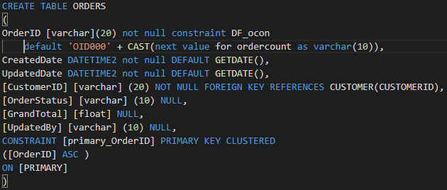
DATA DEFINATION LANGUAGE SCRIPTS

Slide 5
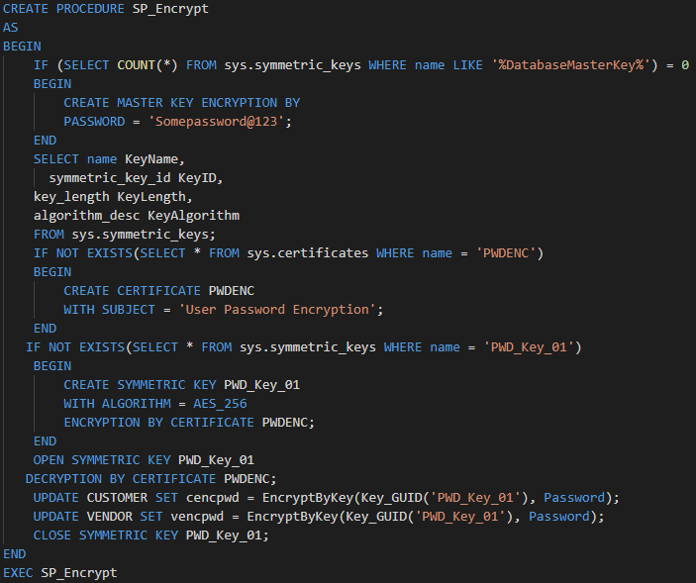
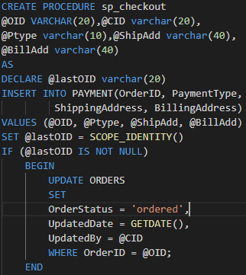
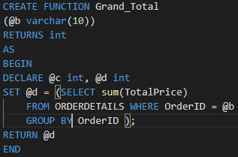
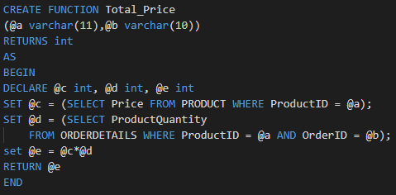
STORED PROCEDURES & USER DEFUNED FUNCTIONS
Functions

Slide 6
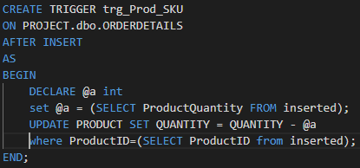
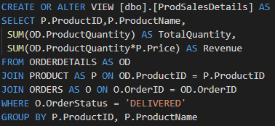
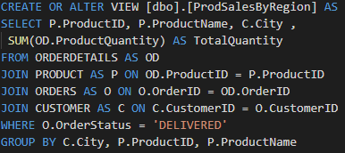
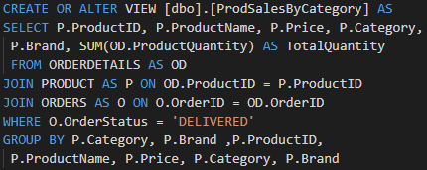
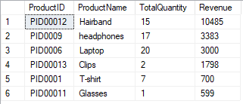
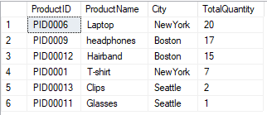
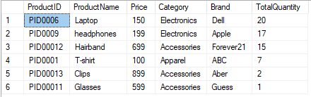
TRIGGERS & VIEWS

Slide 7
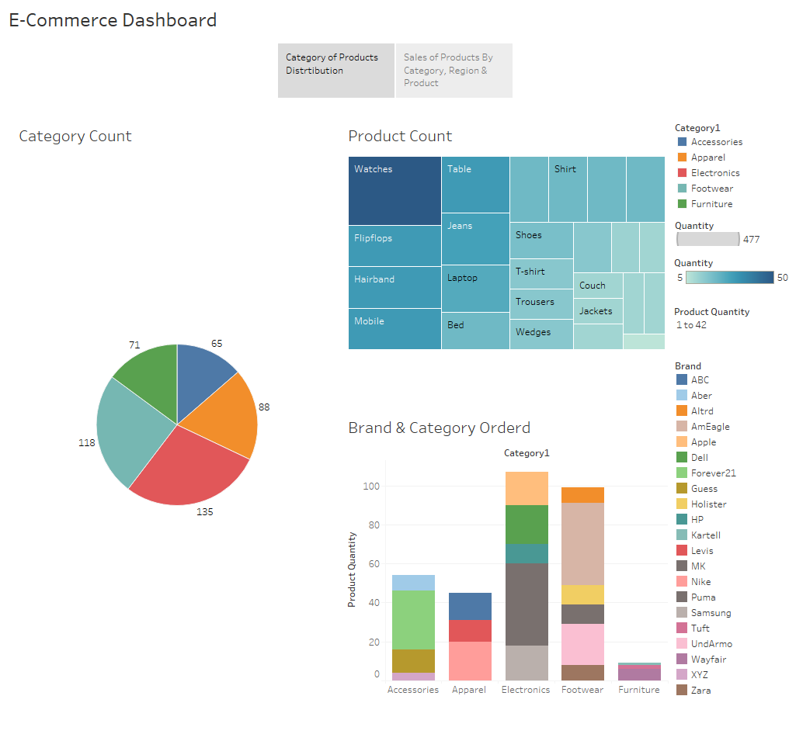
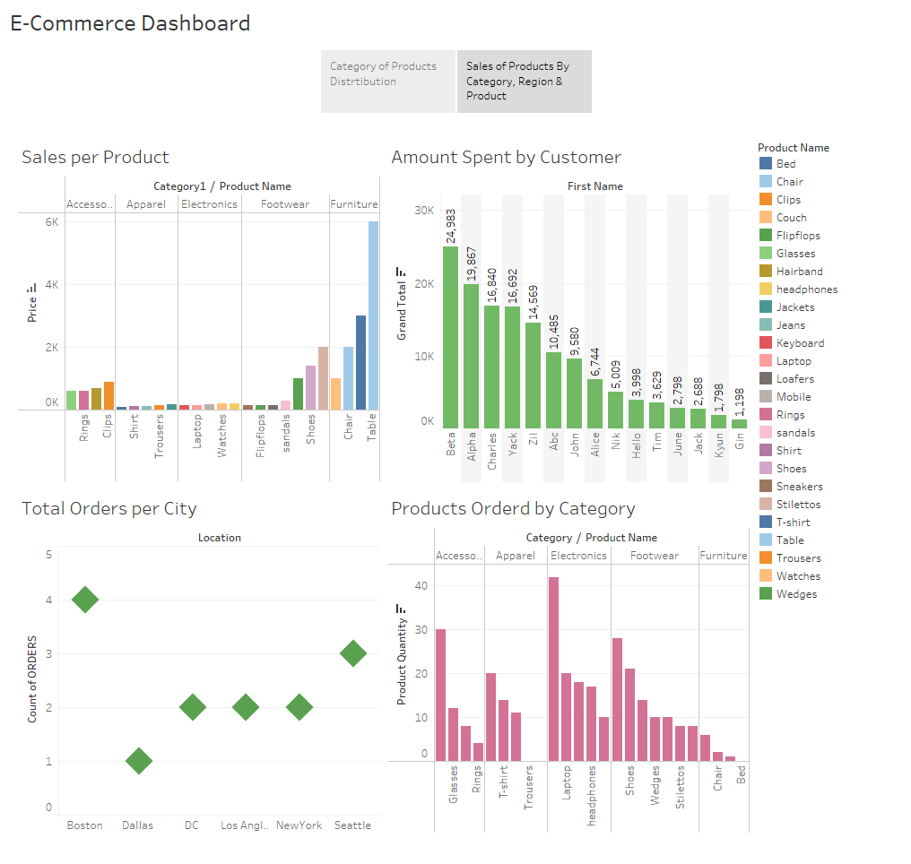


Slide 8

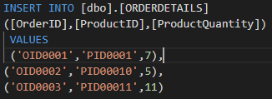
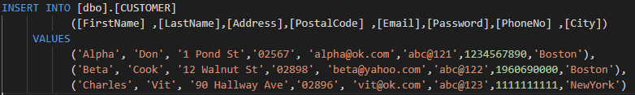
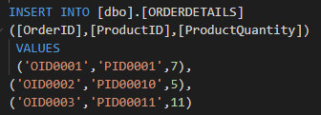
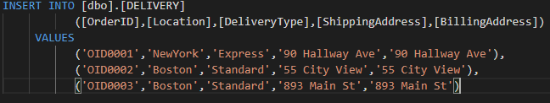
INSERTION OF SAMPLE DATA

